Slide 1


RECIPE MANAGEMENT SYSTEM
Technical WORKFLOW
Presenter >> GAURAV KUMAR JHA

Slide 2
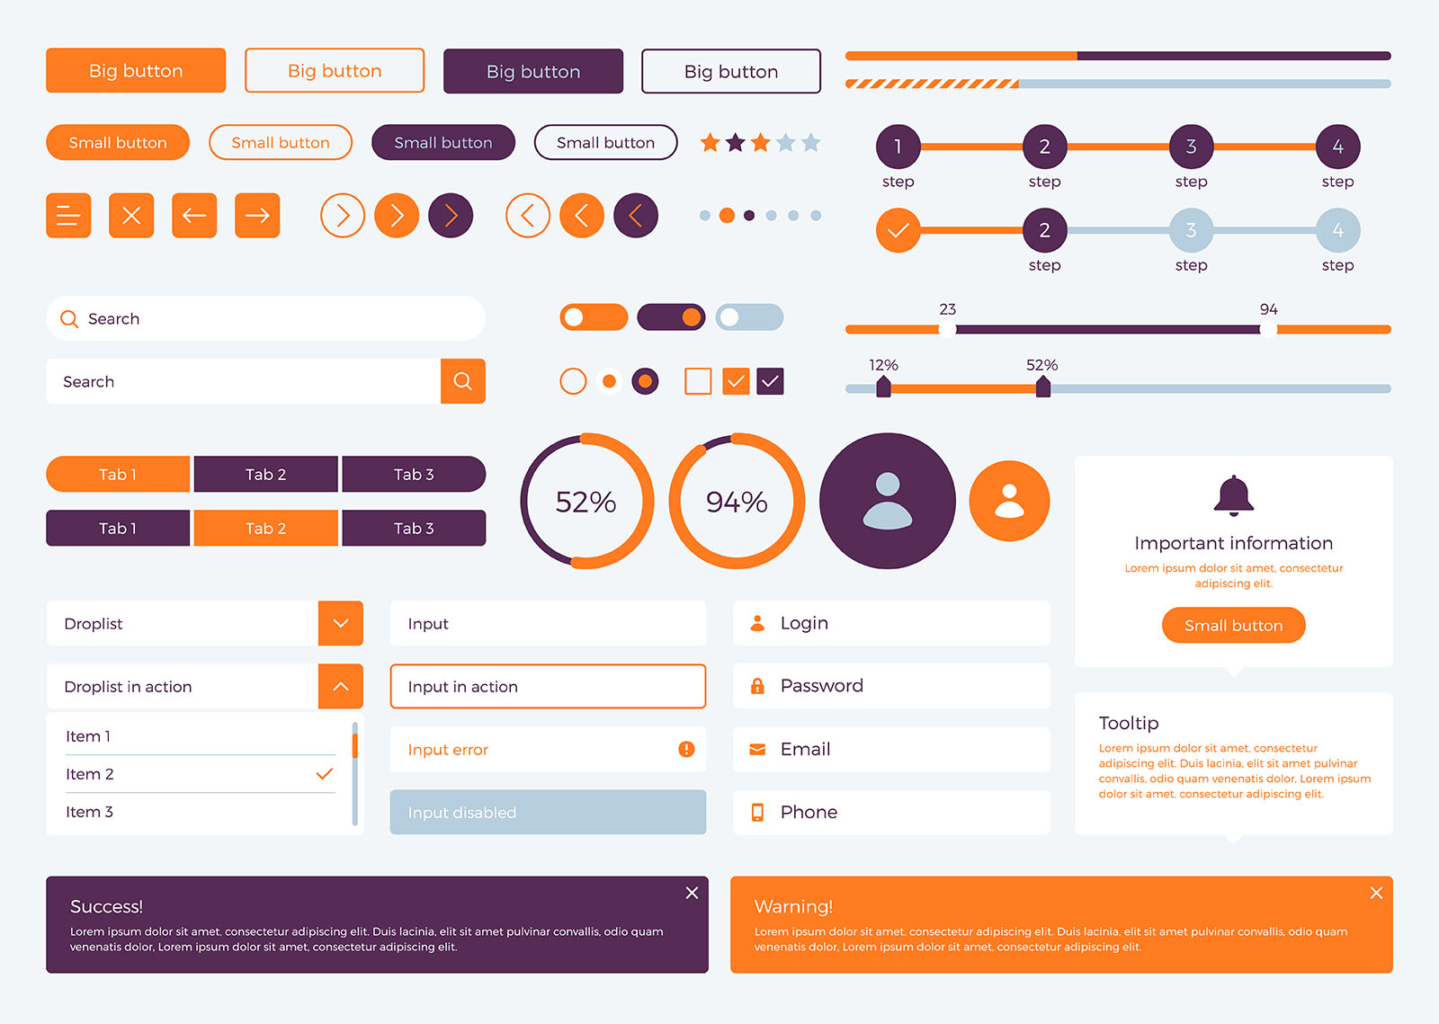
TOOLS & SOFTWARE
FRONTEND
user interface
user experience
01
UI/UX
UI
This is specific set of visual elements and interactive components that users interact with – “the look and feel”
UX
This is overall experience a user has while interacting with your system. User should be able to find the recipes they want quickly and easily.

Slide 3

02
HTML - Structure
Core Task : Define the basic layout and content elements for recipe list, recipe details, and options , etc.
Key Tools : HTML5
02
CSS - Presentation
CODE EDITOR
VS Code
Core Task : Style the HTML to make it visually appealing, user-friendly, and responsive across devices.
Key Tools : CSS3
When interpreter find references to CSS(either via <link> tag, <style> tag, or style attribute),it fetches and applies those styling instruction to then HTML elements.

Slide 4
BACKEND OVERVIEW
Server Receives
Starts the communication with the backend
The process begins with the client (e.g., your web browser) sends a request to the server
Routing
Determines which endpoint to use
Handles request via HTTP protocol (basically inspect the request)
Direct requests to the correct handler
Controller
Process logic and actions
Database
Fetches or store data if needed
Response
Send data back to the client

Slide 5
Technologies Involved (BACKEND)
PROGRAMMING LANGUAGES
JavaScript (Node.js with framework like Express.js
WEB SERVER
Apache
DATABASE
MySQL (Structured data storage with tables and relations),
CODE EDITOR
MongoDB (NoSQL database storing flexible document data)
CSV File (Used as container to store data)
VS Code
API Paradigms
REST (Representational State Transfer)
CLOUD PLATFORM
Google Cloud Platform

Slide 6
KEY TAKEAWAYS
Backend handles client requests and responses
Routing and Controllers manage request flow and logic
Database store and retrieve application data
API enable communication between client and backend

Slide 7


